Slide 1
Final Year Presentation
(Part 2)
Name : Carol Michelle Aralis
ID No: 1051109514
Moderator : Dr. Tawfig Ahmad A. Eltaif
Supervisor : Dr. C. Senthilpari

Slide 2
Project Title 4534:
DESIGN AND IMPLEMENTATION OF DIGITAL LOCK SYSTEM WITH BUILT-IN CAMERA

Slide 3
Aims and Objectives
To integrate a digital lock device with a camera and to function as a single working unit.
To select a facial recognition technique and design a practical biometric verification system.
To simulate the facial recognition access device using software tools and incorporated into the system hardware.
To develop and test prototype

Slide 4
Security Facts at Homes
Locks are used.
Many years very basic locks made of wood and rope until the modern dead bolt or magnetic locks.
One common similarity which would be the need of using a key to release the locking mechanism.
This has made locks become renowned for their ease to break into, as burglars have become experienced at picking, and allowing themselves smooth and easy entry through a key lock.

Slide 5
Security Facts at Work Places
Digital locks are used.
Digital locks are now widely used compared to conventional locks as it eliminates the need for the traditional key.
Conventional digital locks only receive password and doesn’t have any other form of additional security
At times, a breach of security happens due to reasons such as stolen passwords or by system hacking.

Slide 6
Flow Diagram of Project
Study & History
Role & Strategy
Scheme & Replication
Source code & Matlab
Progress & Analysis
Model

Slide 7
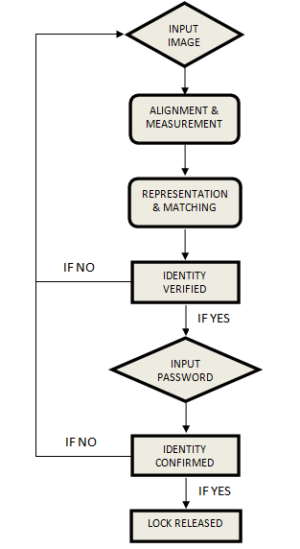
Device Flow Diagram

Slide 8
Program Flowchart
Start
The digital lock is activated and the verification process starts
Input Image
Individuals image will be captured and the facial features of extracted for processing.
Image match
Input image will be compared to the database images to determine if the individual is matched or not.

Slide 9
Program Flowchart
Start
Input Image
Image Match
Input Password
Individual Identity Confirmed
Lock Unlocked

Slide 10
Program Flowchart
Input Password
The individual inputs the password into electronic lock.
Identity confirmed
Identity of the individual is confirmed once the password matches the individual image
Lock release
The lock will unlock when the correct password is inputted for the correct individual. Then it will relock till the next input is given

Slide 11
Program Flowchart
Start
Input Image
Image Match
Input Password
Individual Identity Confirmed
Lock Unlocked

Slide 12
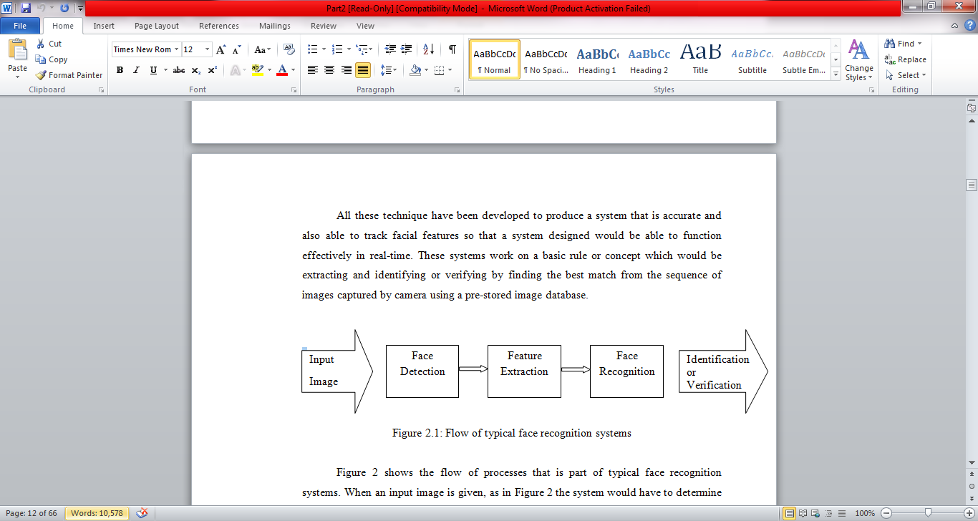
Flow of face recognition systems

Slide 13
Face Recognition Technique
The face recognition technique that has been chosen for this project is the Eigenfaces technique.
This method provides a high enough accuracy rate to be used in real-time.
Eigenfaces technique is also able to provide real-time recognition of faces with minimal constraints.
The detection and recognition ability of this method shows a high reliability among other methods and is suitable for the use in this project.

Slide 14
Face Recognition
Flow Diagram

Slide 15
Begining
Load Database Image
Eigenfaces on Database Image
Weight of Database Image
Input Image
Weight of Image
Compare Weight Values
Display Outcome
End

Slide 16
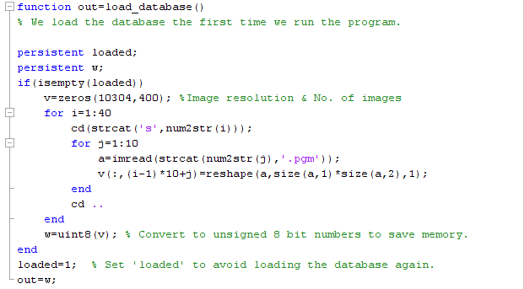
Face Recognition Program
Training Set

Slide 17
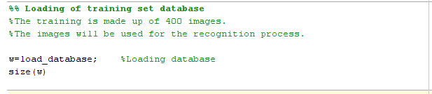
Main program

Slide 18
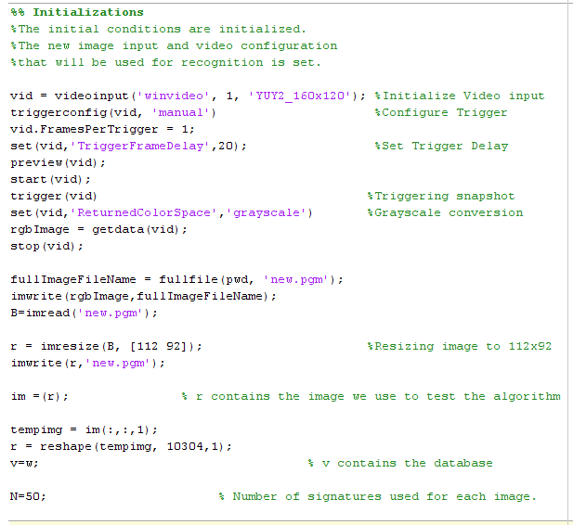

Slide 19
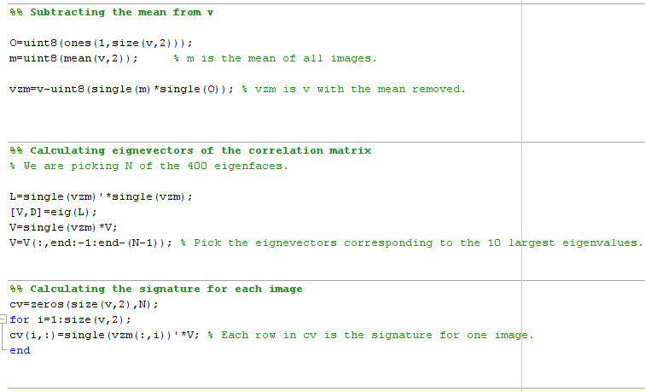

Slide 20
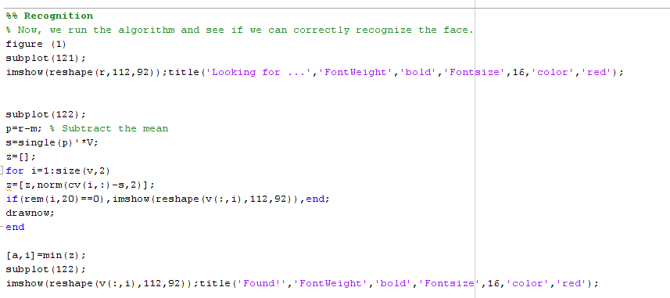

Slide 21
Example of output

Slide 22
Digital Lock
Flow Diagram

Slide 23
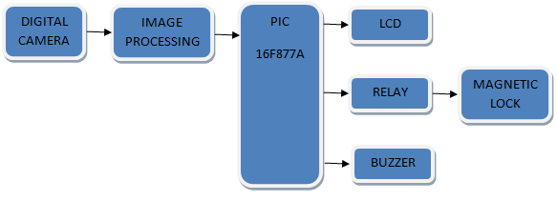

Slide 24
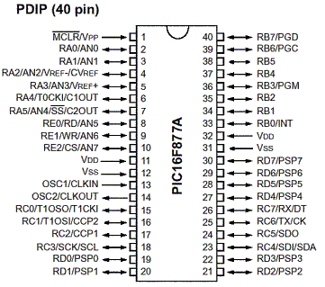
Hardware Component Explaination
PIC16F877A MICROCONTROLLER

Slide 25
PIC16F877A MICROCONTROLLER
The PIC16F877A is used to manipulate the locking system for the digital lock device. It is the most vital part in the hardware device. The microcontroller is programed to compile the program of the device in its memory.

Slide 26
LCD SCREEN DISPLAY
LCD display is selected to display words for simple notifications and password symbols for the locking device.
The word contrast of the LCD can be adjusted using potential meter for clearer or better viewing depending on the need and lighting conditions.
These connections provide the power supply, input values and also to display the words and password symbols.

Slide 27
KEYPAD
A 4x4 keypad is used as an input device to receive the password or pin number from the individuals that wants to be granted access.
The keypad consists of 16 different inputs, 10 which are numerals (0-9), 4 alphabets (A-D) and 2 additional symbols.

Slide 28
RELAY AND BUZZER
A relay and buzzer is used as the output of the device to show that the circuit functions as desired.
The relay can be connected to a magnetic lock and when the relay is triggered, the magnetic lock would lock or release the lock.
The buzzer functions as an alarm to notify if there is a breach or a forced entry.

Slide 29
SCHEMATICS

Slide 30
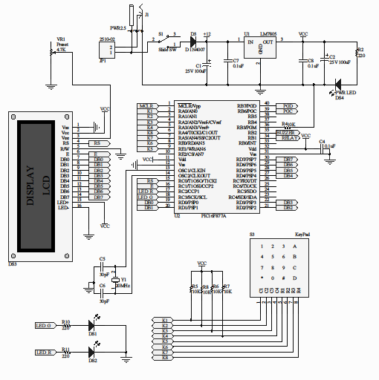

Slide 31
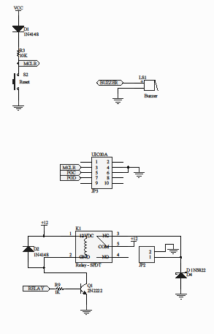

Slide 32
QUESTIONS AND DEMO

